Slide 1
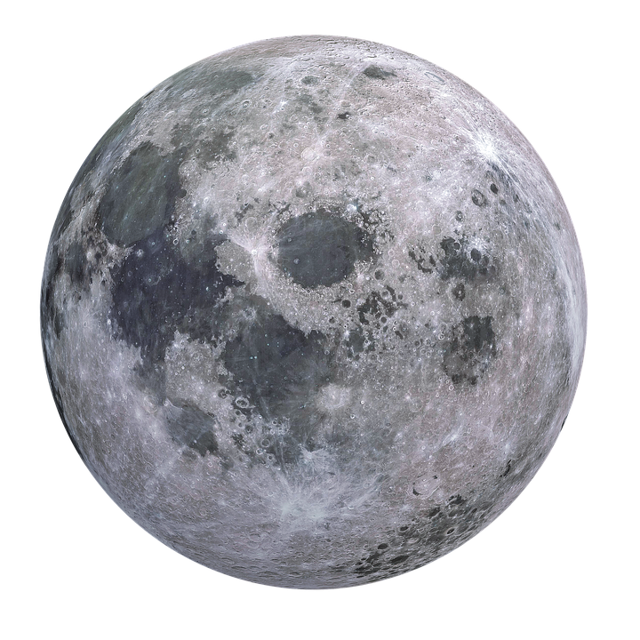



Giordano Bruno: Secondary impact cratering processes on the Moon
Alexia Kubas
Mentors: Dr. Christopher Hamilton (LPL), Dr. Michael Zanetti (NASA MSFC)
Arizona Space Grant Consortium Symposium
April 23, 2022

Slide 2
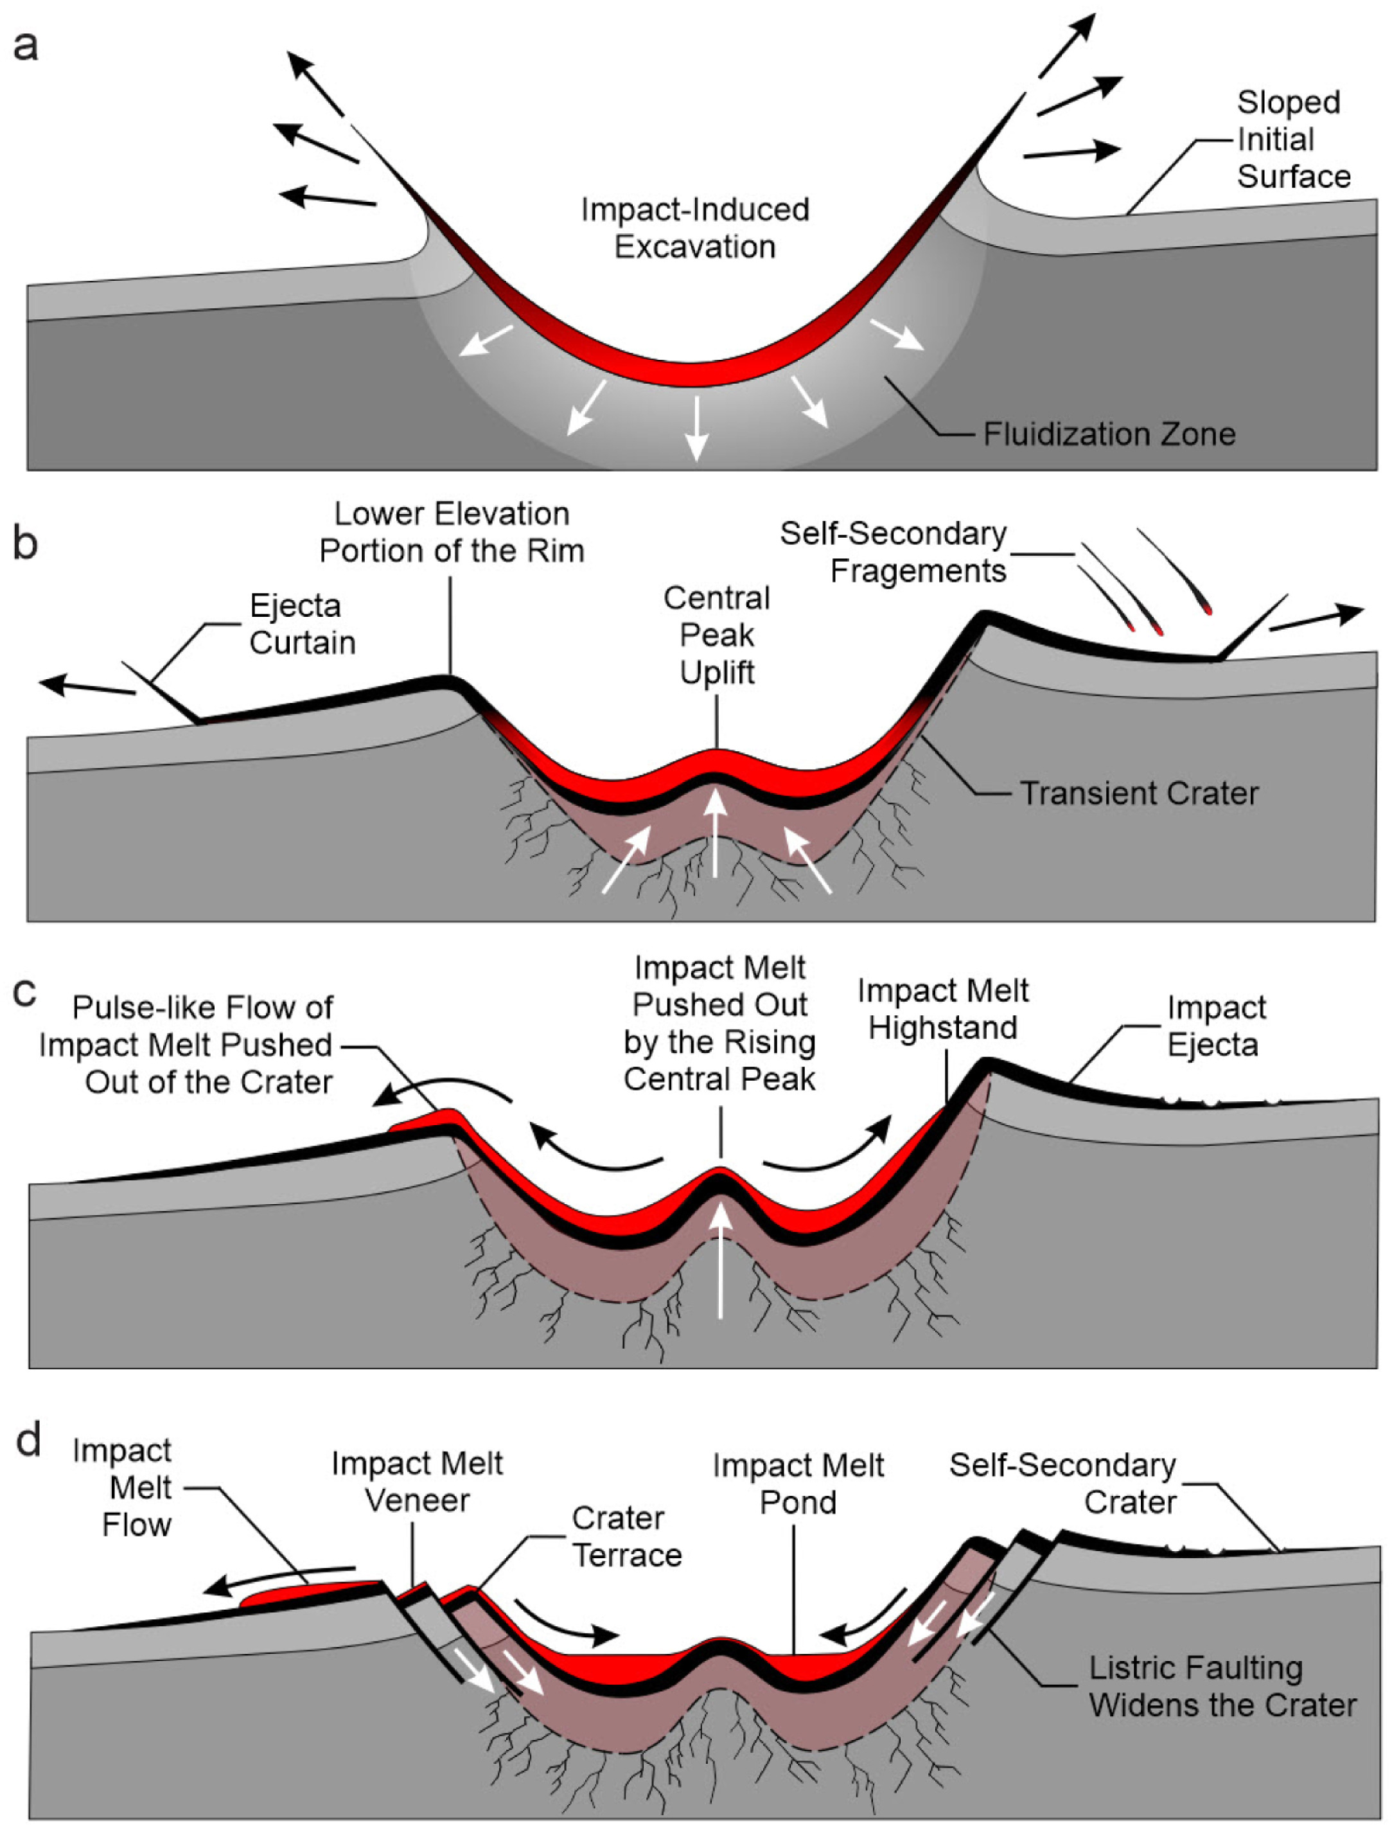
Introduction
Crater-counting is an integral method of estimating ages of planetary surfaces
Production function (PF)—model describing the cumulative number of new lunar impact craters per km per Gyr
Crater-counts + PF = crater size–frequency distribution (CSFD) and absolute model age (AMA) of planetary surface
Primary vs. Secondary craters
Crater-counts on continuous ejecta blanket to age-date parent crater

Slide 3
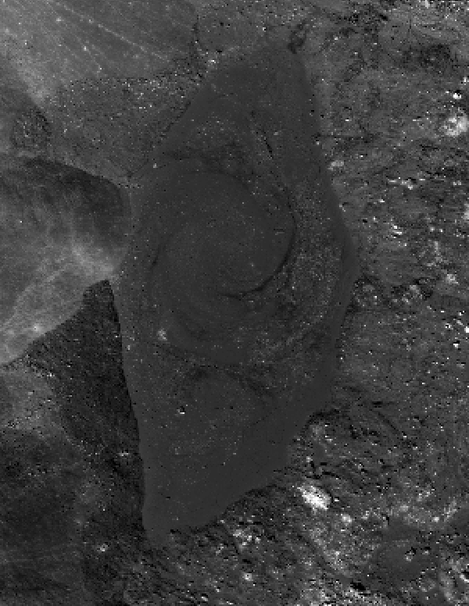
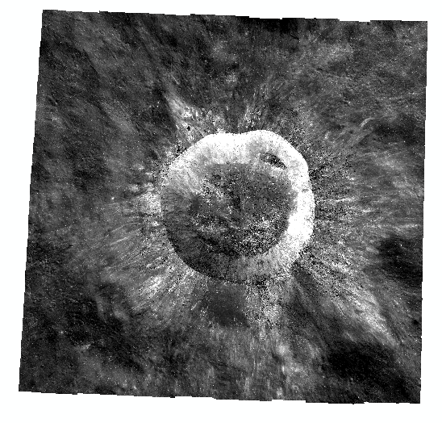
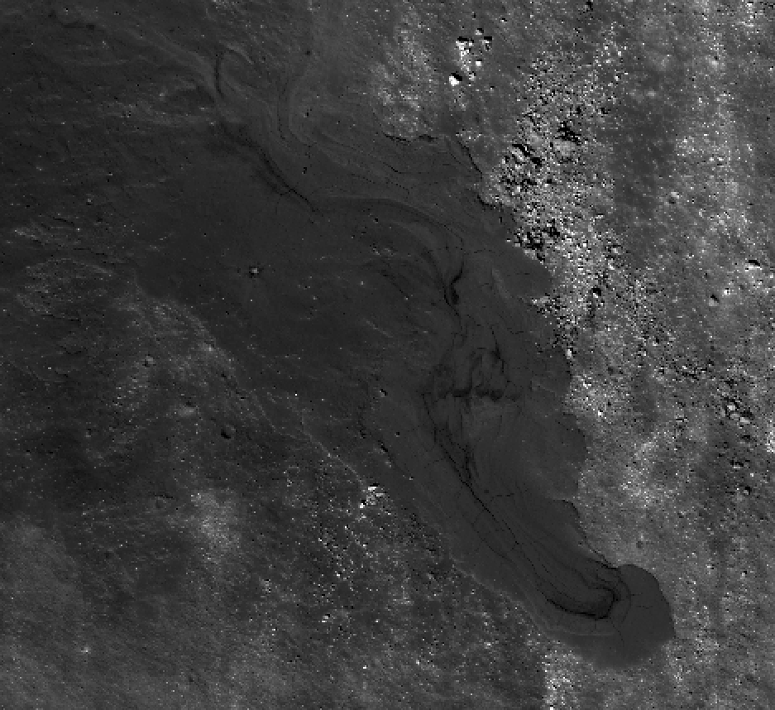
Introduction
Giordano Bruno—Copernican crater on lunar far side
D = 22 km
Age estimated to be 1–10 Ma (Morota et al., 2009; Plescia & Robinson, 2019)
0.5 km
10 km
0.5 km
NASA/LRO

Slide 4
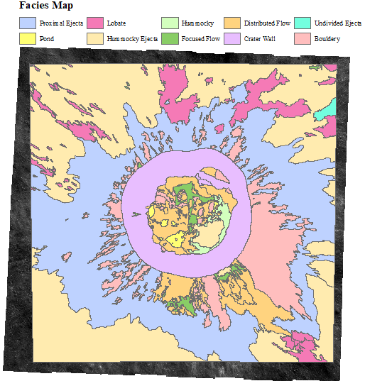
Introduction
Composed of various surface morphologies that reflect different origins—facies
Facies that were created by the formation of Giordano Bruno (crater floor, continuous ejecta blanket) should have the same AMAs, but do not.
Why do different parts of the crater have different AMAs, and how does this affect the way we estimate ages of planetary surfaces?
10 km

Slide 5
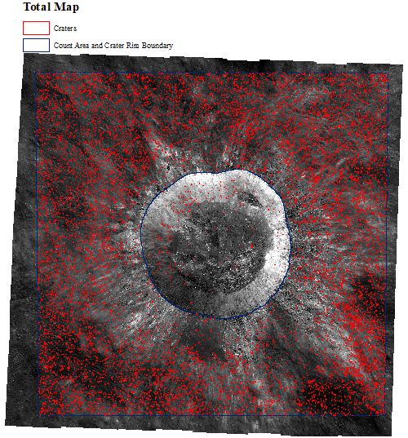
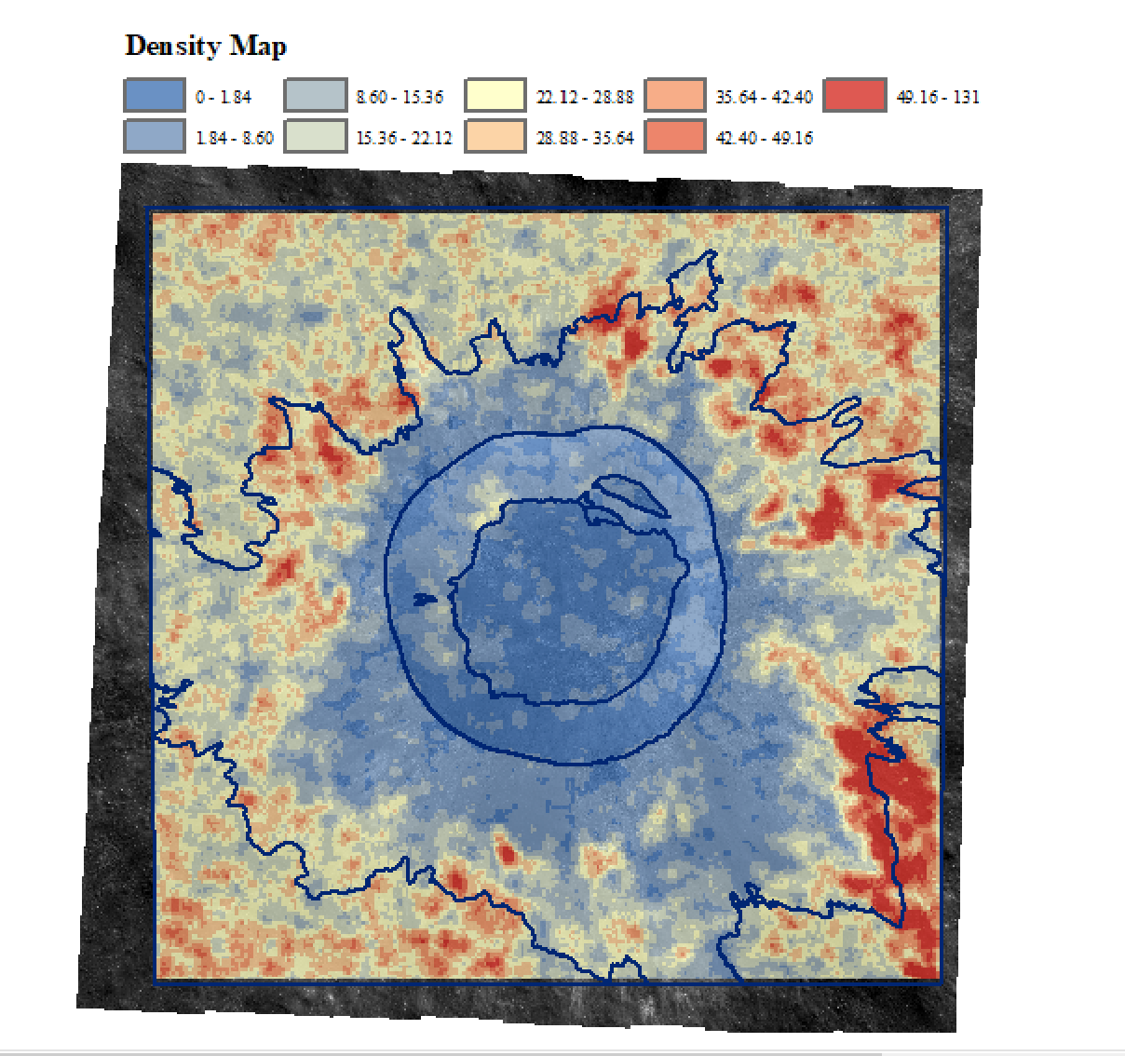
Methods: Crater-Counting & Density Map
Digitized 47,130 impact craters with 10 m < D < 290 m within ~2500 km² surface area
Created density map to analyze how number density of craters varies across Giordano Bruno
10 km
10 km

Slide 6
Methods: CSFDs and AMAs
Separated craters into shapefiles according to facie
Used Craterstats2 software to plot CSFDs of facies (Michael & Neukum, 2010)
Used the Neukum 2001 PF to calculate the AMAs of facies (Neukum et al., 2001)

Slide 7
Results: Density Map
Crater density increases with radial distance away from the crater rim
The lowest concentration of craters occurs within the crater floor region
The densest concentrations occur on the outskirts of continuous ejecta blanket
Most prominent in the southeast
Bouldery and impact melt (Distributed Flow and Focused Flow) facies have lower crater densities than the Proximal Ejecta, corresponding to younger AMAs
10 km

Slide 8
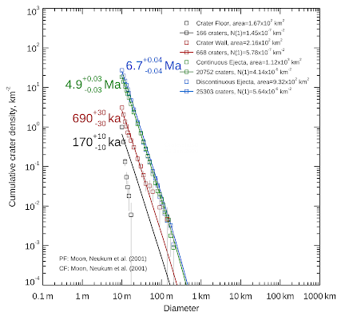
Results: CSFDs and AMAs
The crater floor has the youngest AMA
The crater floor CSFD is much steeper than its corresponding isochron (unable to fit to data)
Less craters than expected by PF
Crater Floor Crater Wall Continuous Ejecta Discontinuous Ejecta

Slide 9
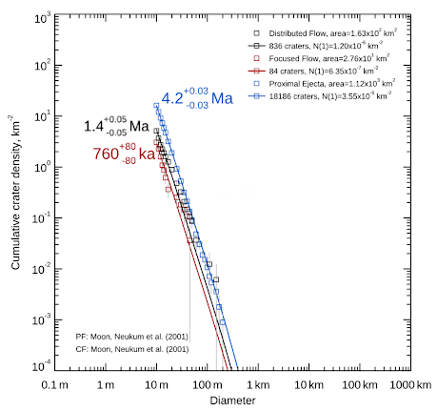
Results: CSFDs and AMAs
Facies comprising continuous ejecta blanket have different AMAs
Impact melt (Distributed Flow and Focused Flow) AMAs millions of years younger
Proximal Ejecta has many more small-diameter craters per unit area
Distributed Flow Focused Flow Proximal Ejecta

Slide 10
Discussion
Why do facies on the continuous ejecta blanket have different AMAs?
Target Properties: Differences in material properties between melt and ejecta affect crater production
However, difference in melt and ejecta CSFDs not constant at all diameters
Some process producing an abundance of small-diameter craters on the ejecta…
Distributed Flow Focused Flow Proximal Ejecta

Slide 11
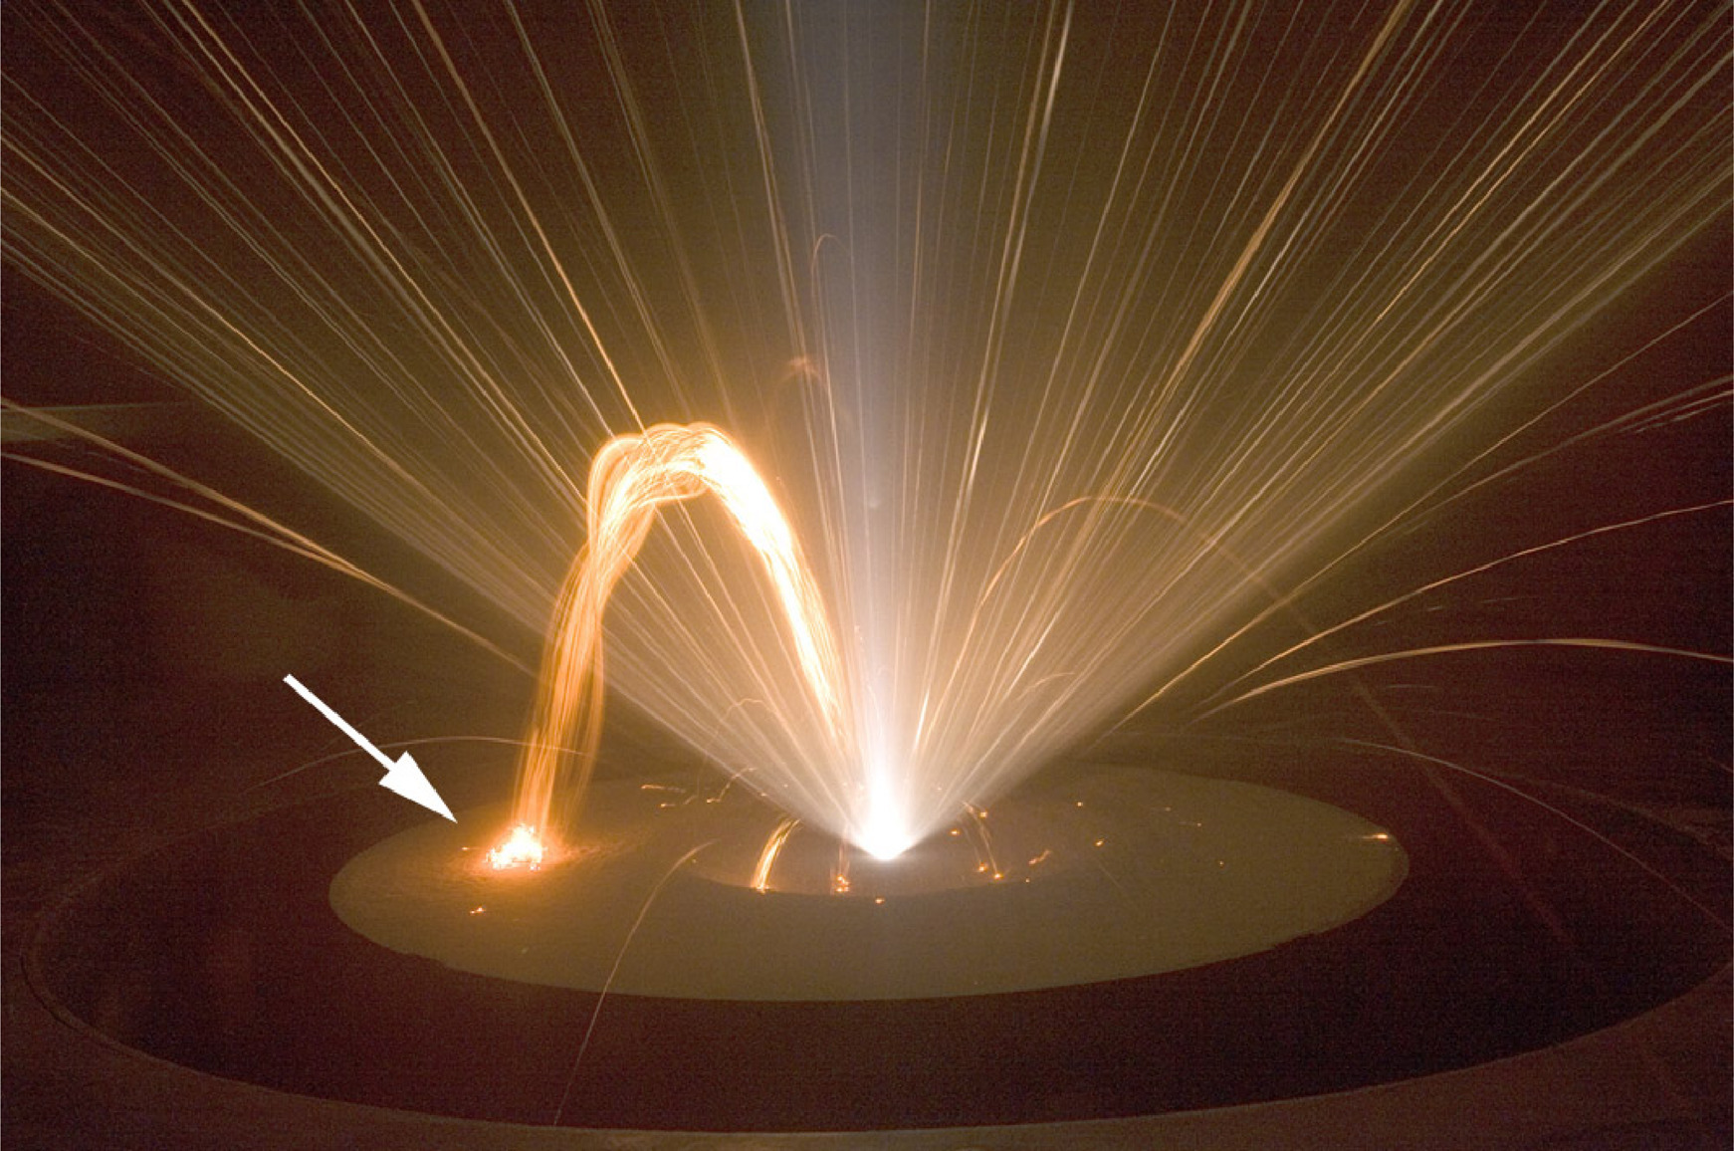
Discussion
Self-Secondary Cratering: During parent crater excavation, ejecta fragments launched at near-vertical trajectories may fall back to the surface and impact the continuous ejecta blanket
Impact melt would have still been mobile during the creation of SSCs
AMA of Proximal Ejecta inflated by the presence of SSCs, whereas impact melt AMAs more representative of age of Giordano Bruno
C. Ernst, JHU/APL, Plescia & Robinson (2019)

Slide 12
Conclusions
AMA discrepancy on continuous ejecta blanket due to SSCs
Crater-counts on continuous ejecta blankets used to age-date parent crater— modified to only count on impact melt when possible
Most lunar craters do not have impact melt, so need other method of filtering out SSCs
Measured cratering rate on continuous ejecta blankets may be overestimated— need impact cratering model to account for SSCs
As we learn more about SSCs, the way we approach crater-counting will evolve

Slide 13
Thank You!

